Slide 1
CIT 228 Data visualization project
Russell Arlt

Slide 2
AGENDA
Introduction/ why invest?
Earthquake Data
Comet Data
Food Data
The REVEAL
Summary

Slide 3
INTRODUCTION
Greetings investors and business moguls!
Thank you for taking time to attend my virtual investment opportunity, and let me tell you, you WON’T be disappointed. Let’s start simple. The world is a dangerous place, with many perils. How does one create a thriving business in a time like this? Well. Let’s find out together.

Slide 4
EARTHQUAKES!!!!
There can’t be that many right?

Slide 5
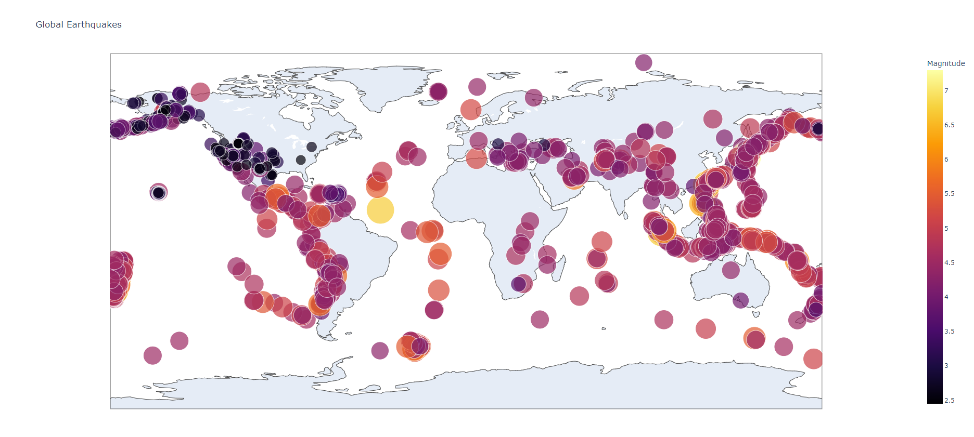
WRONG!
https://lisabalbach.com/arlt9/228/global_earthquakes.html
Citation U.S. Geological Survey: https://earthquake.usgs.gov/earthquakes/feed/v1.0/geojson.php#earthquakes

Slide 6
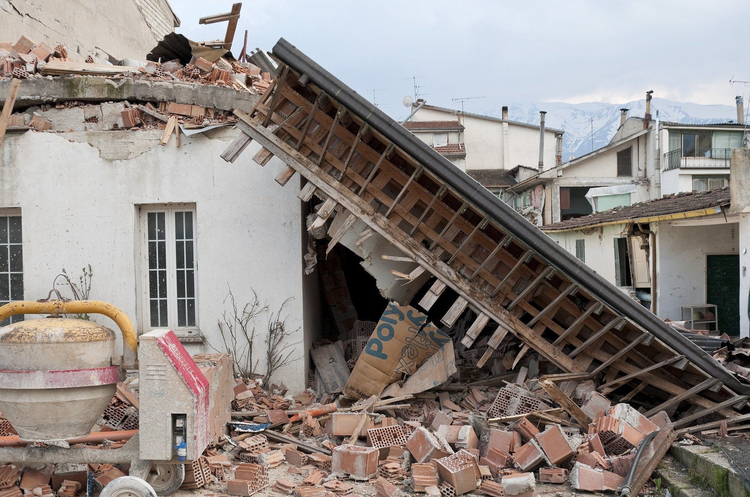
https://pixabay.com/users/angelo_giordano-753934/

Slide 7
Comets!?
They can’t be related in any way to this presentation though right?

Slide 8
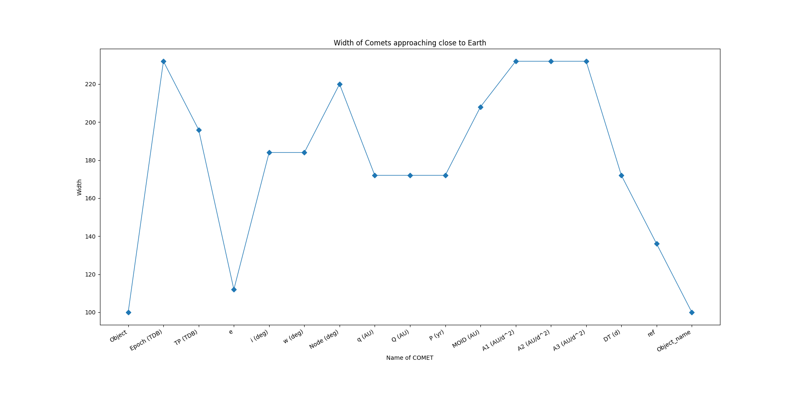
WRONG AGAIN!
Citation Data.Gov: https://catalog.data.gov/dataset/near-earth-comets-orbital-elements/resource/004f2e90-04b7-4358-a402-7742015f02b8

Slide 9
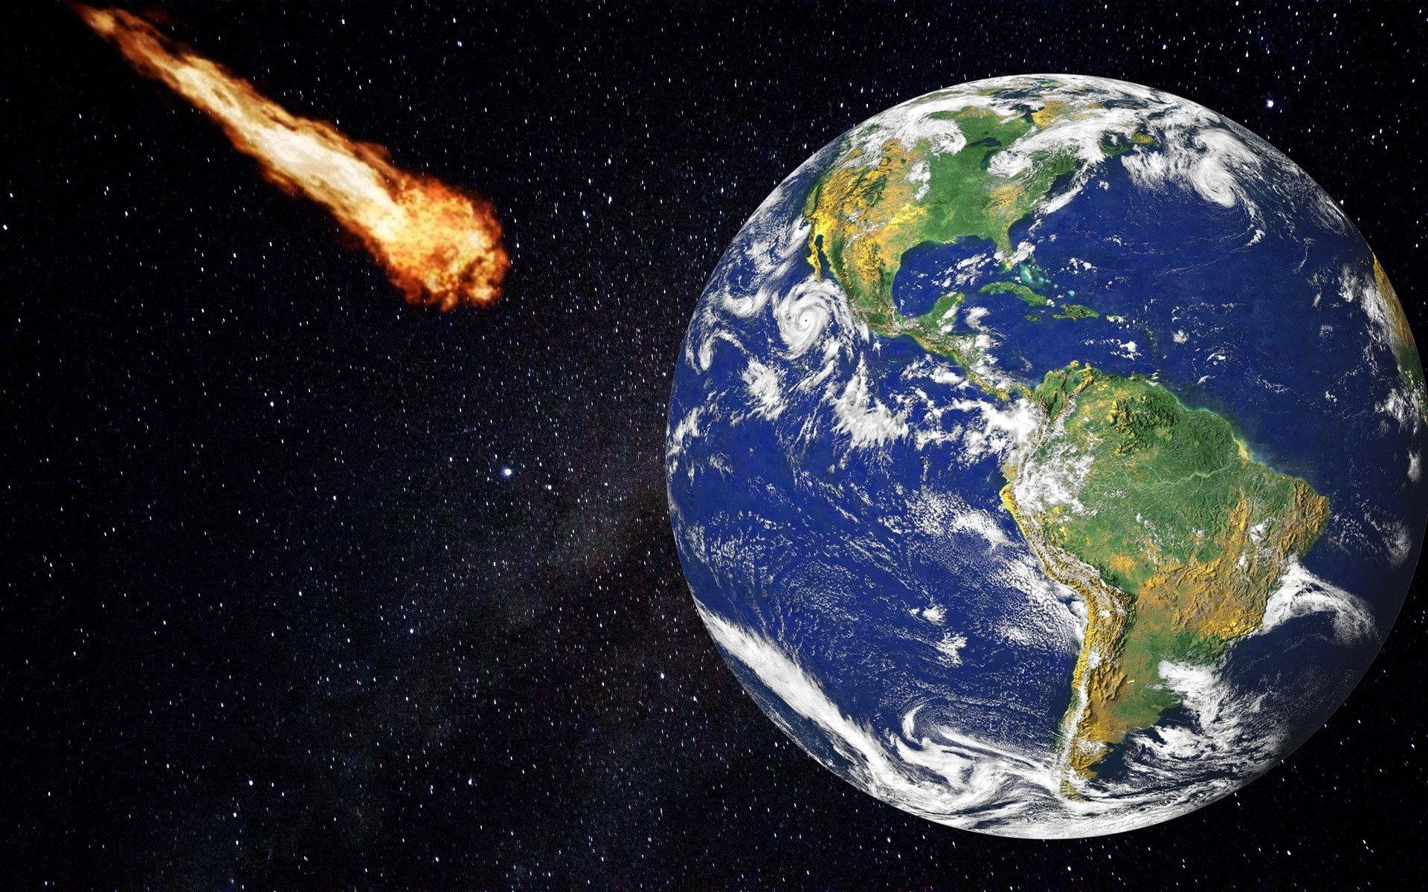








MEET OUR TEAM
TAKUMA HAYASHI
MIRJAM NILSSON
RAJESH SANTOSHI
RAJESH SANTOSHI
President
Chief Executive Officer
Chief Operations Officer
VP Marketing
GRAHAM BARNES
ROWAN MURPHY
ELIZABETH MOORE
ROBIN KLINE
VP Product
SEO Strategist
Product Designer
Content Developer
Image found on Pixabay

Slide 10
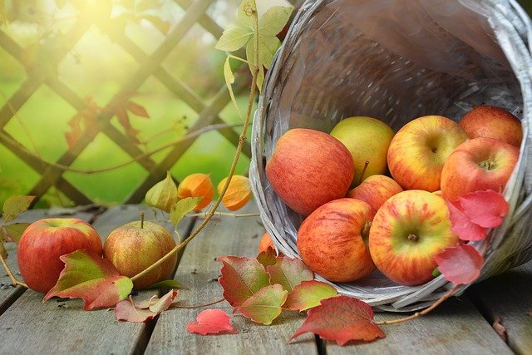
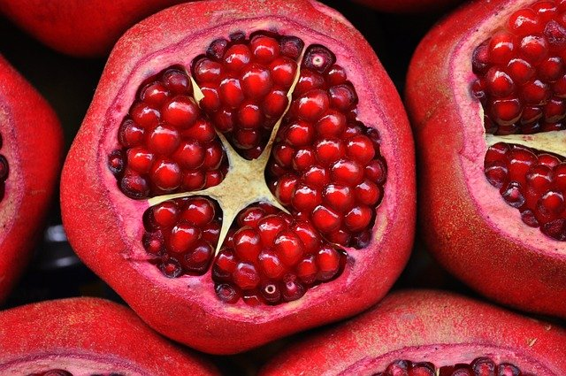
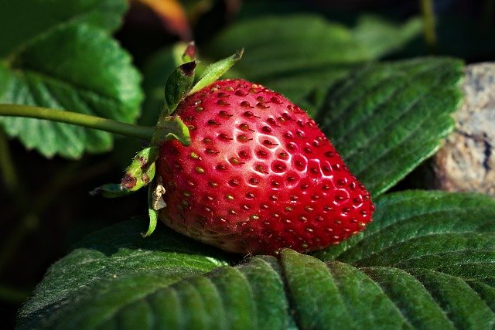
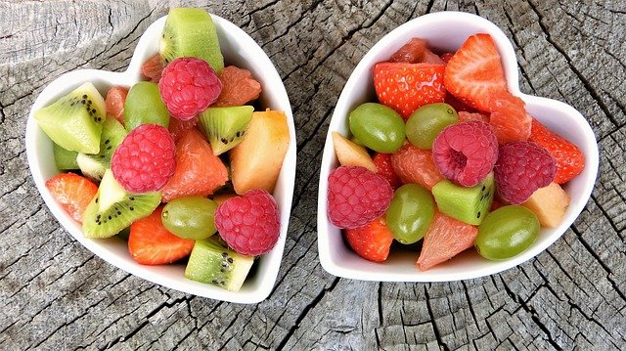
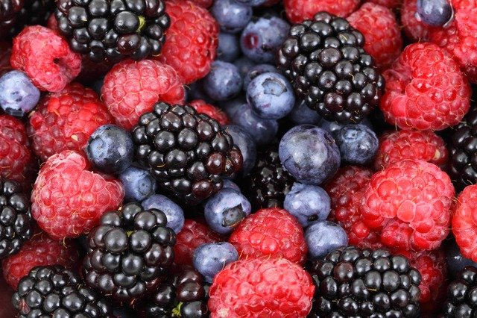
Food Is related to everything!

Slide 11
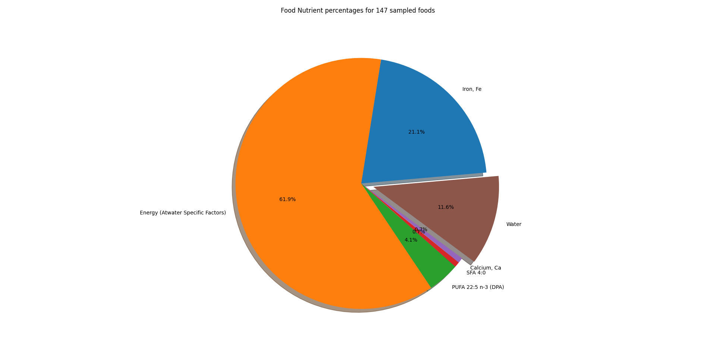
TIMELINE
Q1
Synergize scalable e-commerce
Q2
Coordinate e-business applications
Q3
Deploy strategic networks with compelling e-business needs
Q4
Disseminate standardized metrics
Citation U.S. Department of Agriculture: https://fdc.nal.usda.gov/download-datasets.html

Slide 12
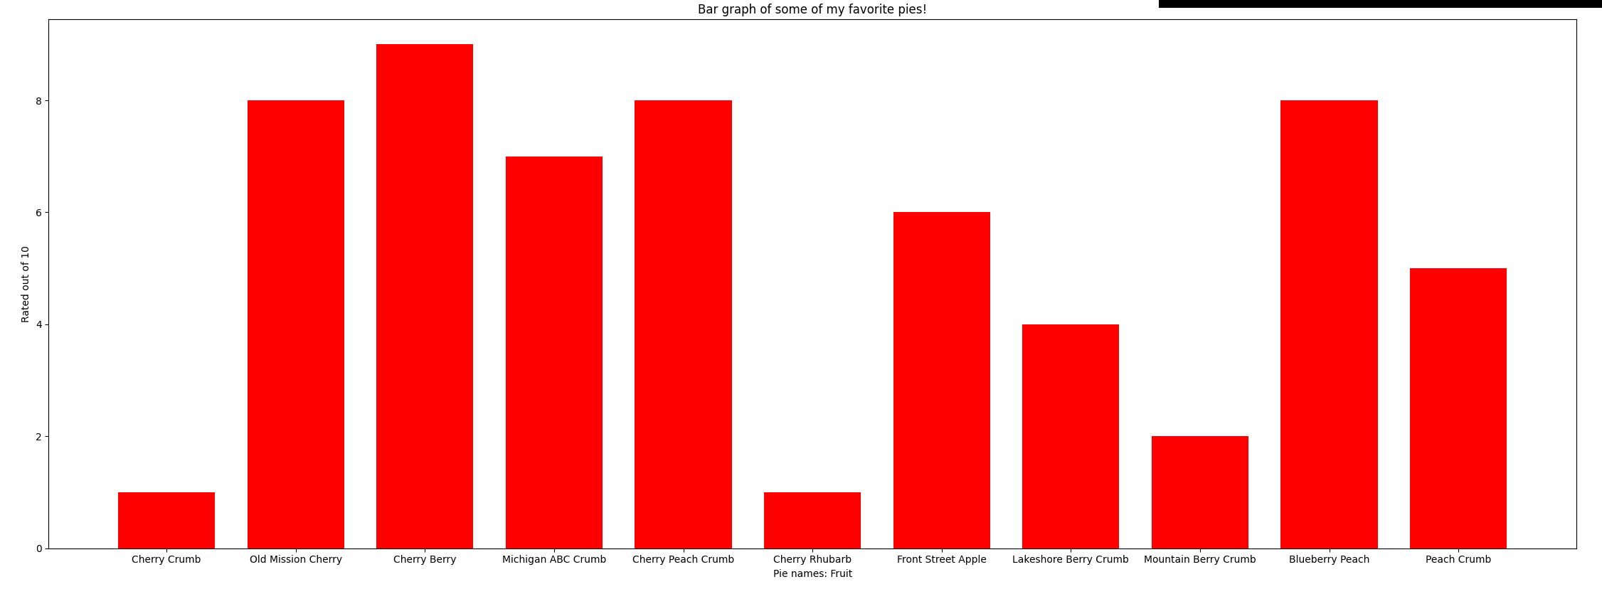
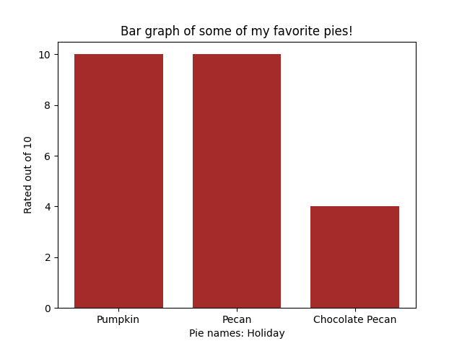
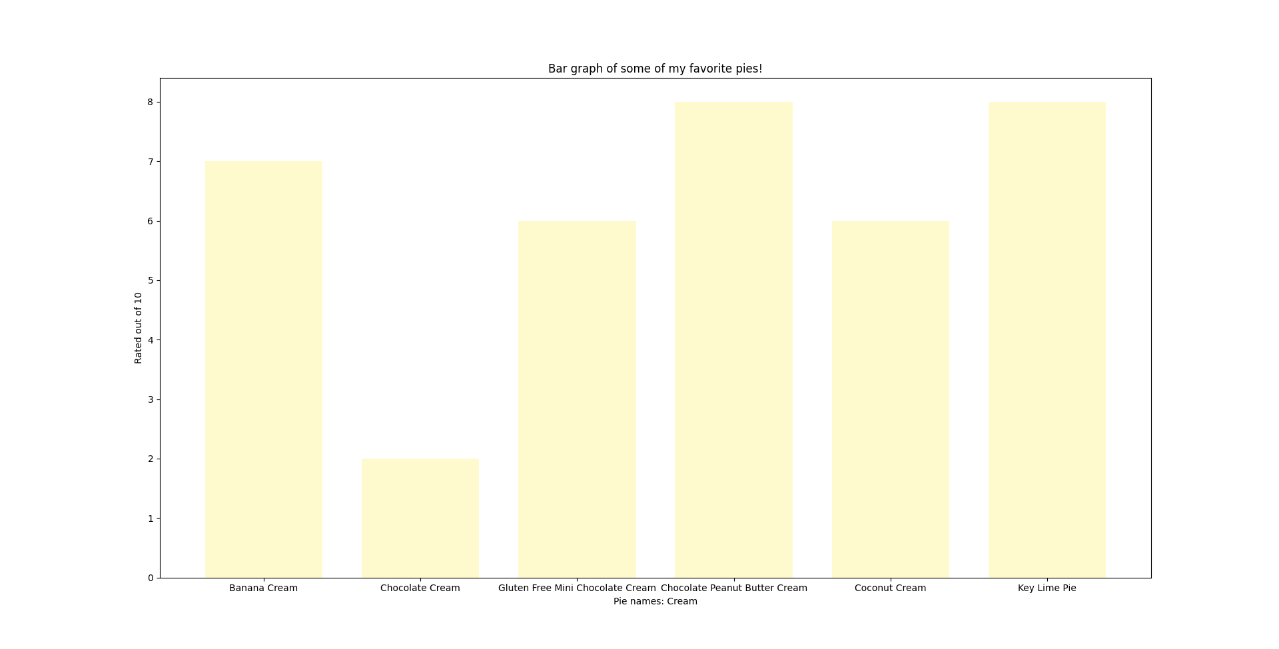
AREAS OF FOCUS
B2B MARKET SCENARIOS
CLOUD-BASED OPPORTUNITIES
Iterative approaches to corporate strategy
​Establish a management framework from the inside​
https://lisabalbach.com/arlt9/228/fav_pies.json

Slide 13
BUT WHAT DOES IT ALL MEAN? I’m glad you ASKED.
Infrastructure that can withstand earthquakes?
A way to stop incoming comets?
The greatest source of amino acid glycine?
https://www.healthline.com/nutrition/gelatin-benefits
Fruit flavor? Like from pies?

Slide 14
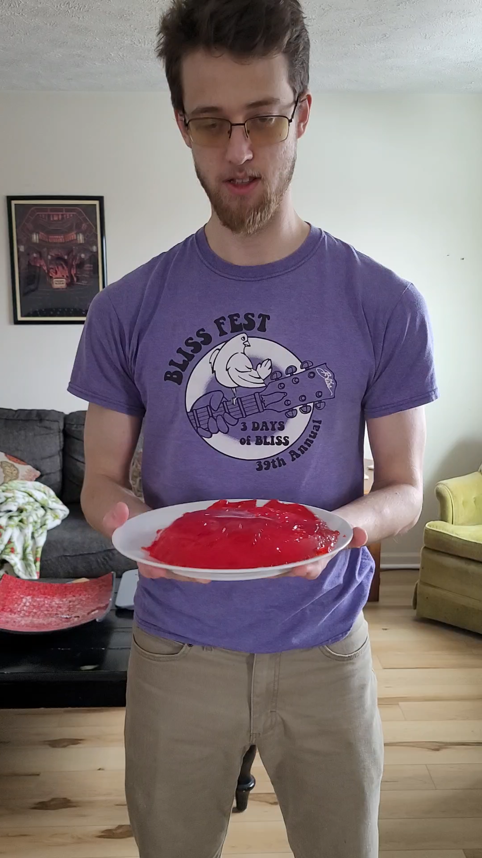
Gelatin! The wonder food
While we continue through life, we keep building infrastructure that cannot withstand earthquakes, but gelatin can! My first investment opportunity is GELATIN HOMES!

Slide 15
Now I know what you are thinking, there can’t be anything more!
But there is……. THE SECOND INVESTMENT OPPORTUNITY!

Slide 16
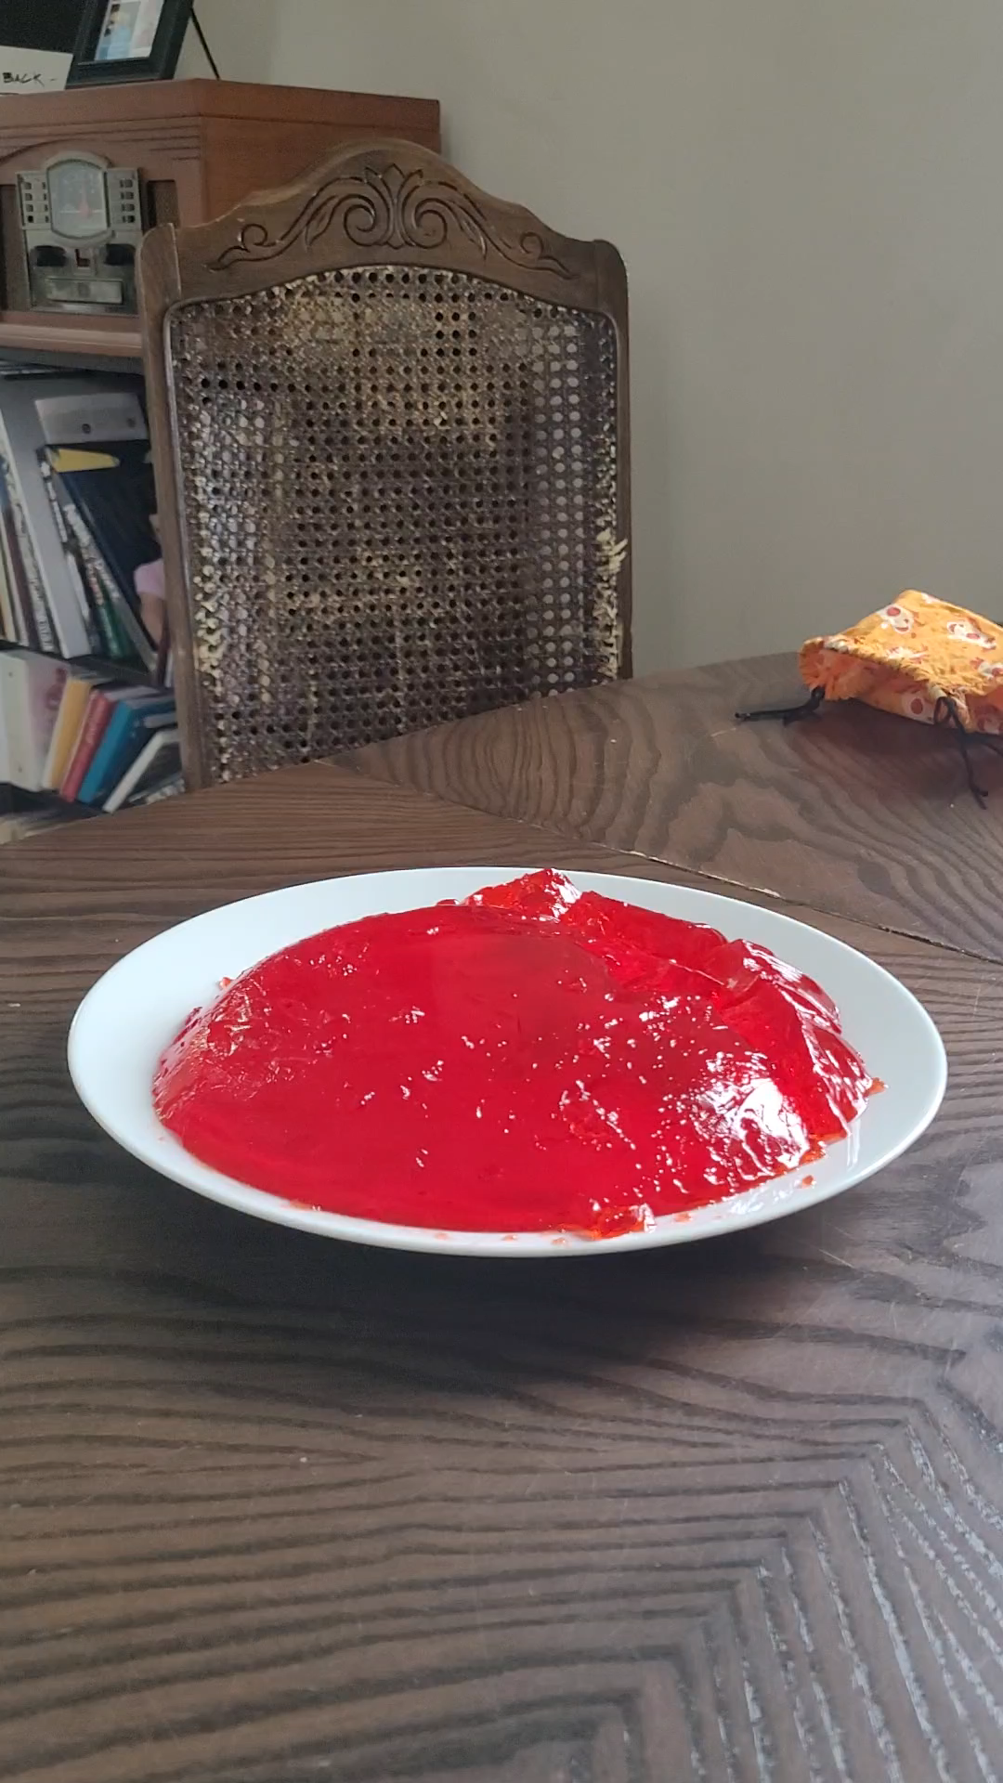
THE gelatin comet and asteroid defense fund!

Slide 17
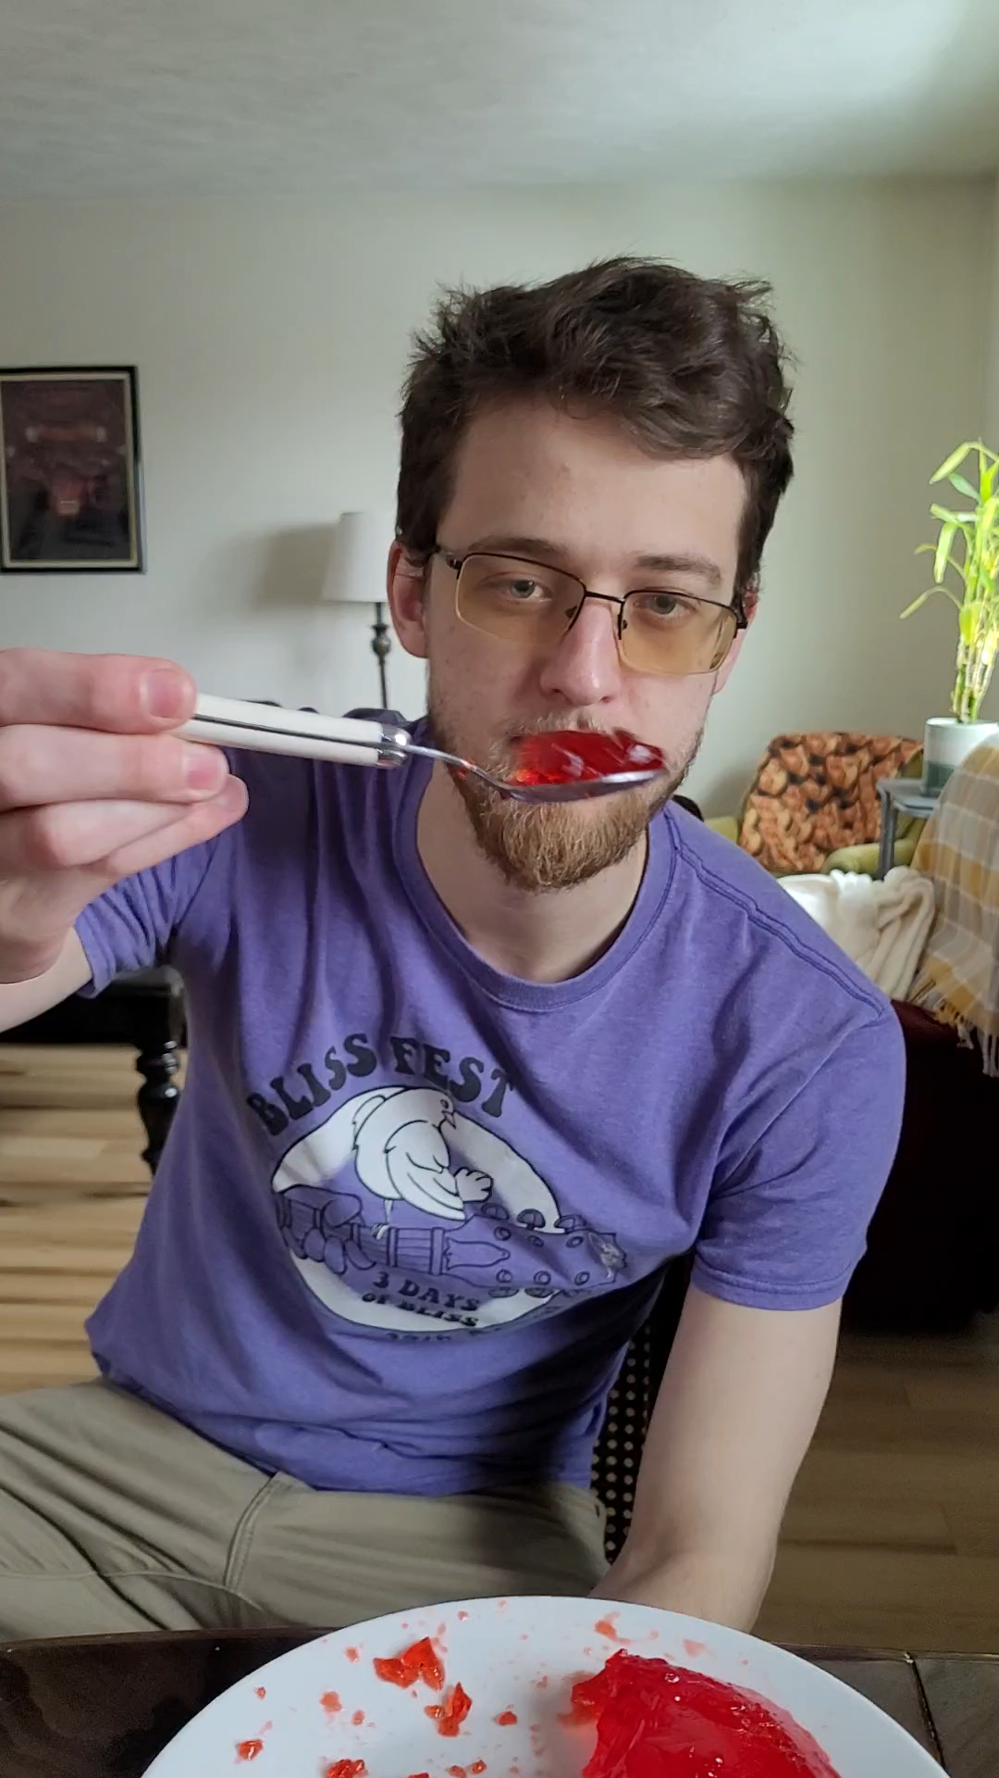
Thank you all for coming to my investment opportunity. I’m looking to start with 100 billion dollars for research. And don’t forget to eat your gelatin!!!! The greatest source of amino acid glycine.

Slide 18
investment opportunities can be followed up at arlt9@mail.nmc.edu

